Slide 1
CSS342 Data Structures, Algorithms, and Discrete Mathematics (I)

Slide 2
Important Info
Syllabus
https://github.com/pdgetrf/UWB_CSS342_2019_Fall
C++
Reason to love C++ ← link
Flexible
Performance
You should be comfortable with C++ at the starting of this class
Already? Good!
Not but willing to catch up? GOOD!

Slide 3
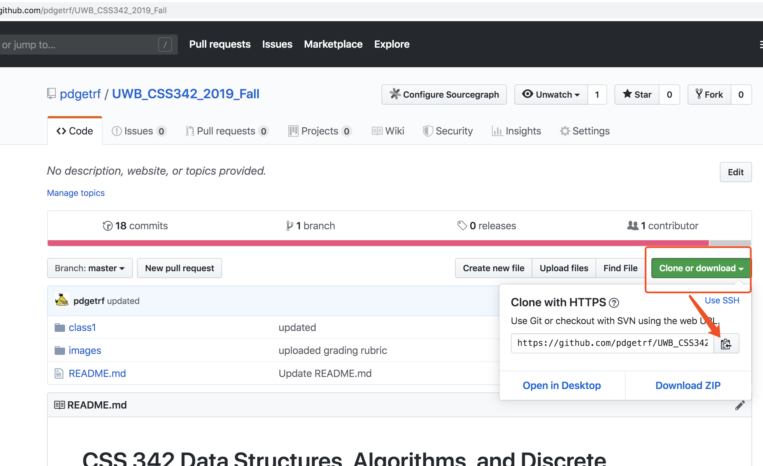
Clone the repo
Git, www.github.com
git clone https://github.com/pdgetrf/UWB_CSS342_2019_Fall.git

Slide 4
Syllabus (TL;DR)
This is a 300/400 level class
Be an independent learner
Resourceful
Academically mature
Ask proper question:
“this is not working!” is not a proper question. What’s the error? What did you try? Be specific
If it’s something you can google, google it
Read the textbook chapters (see schedule) before class
Class material is “inspired” by textbook
I will assume you have already read it at class
Slides as a guideline

Slide 5
Syllabus (TL;DR)
Take notes
Write code on paper
Coding interview for companies is done on white board most of the time. Do not rely on debugger to find bugs.
If you miss the class, you are responsible to catch up!
No late assignment will be accepted
Exception is very very rarely given based on circumstances
No make-up exam

Slide 6
Tooling
OS:
Windows, Linux, Mac
IDE/Editor:
Visual studio, VS Code, Clion, Xcode, Atom, etc.
VIM, Emacs
Makefile, Cmake
Online Editor
Testing:
A review by Clion
Googletest
Source Control
Git, www.github.com

Slide 7
Tooling
OS:
Windows, Linux, Mac
IDE/Editor:
Visual studio, VS Code, Clion, Xcode, Atom, etc.
VIM, Emacs
Makefile, Cmake
Online Editor
Testing:
A review by Clion
Googletest
Source Control
Git, www.github.com

Slide 8
Lecturer
Dr. Peng Du
High performance computing
Cloud computing
Web services
Backend service1
Frontend service1
database
Backend service12
Backend service12
Install sequence:
database
Backend service1
Frontend service1

Slide 9
Here’s a question
Given the service dependencies, what’s the correct sequence to deploy/install these services such that all dependencies relationship is followed?
Service 3
Service 1
Service 4
Service 2
Service 4
4
3
Means “Install/deploy 4 first, and then 3”

Slide 10
Here’s another question
Given the steps and dependencies to make pancakes, what’s the right order step by step?
https://runestone.academy/runestone/books/published/pythonds/Graphs/TopologicalSorting.html

Slide 11
And here’s yet another problem
You need to take N course, and some courses may have prerequisites, for example:
CSS 342:
CSS 133, CSS 143, CSE 143, or CSS 162, and
STMATH 125 or MATH 125
CSS 133, CSS 143, CSE 143, or CSS 162
CSS 342
STMATH 125 or MATH 125

Slide 12
COURSE SCHEDULING PROBLEM
(More) Formal definition:
Given the total number of courses and a list of prerequisite pairs, return the ordering of courses you should take to finish all courses.
Example:
[0, 1], 0 →1, read as “course 0 is the prerequisite of course”
Another example:
[1, 4], 1 → 4, “course 1 is the prerequisite of course 4”
Some courses don’t have prerequisite

Slide 13
COURSE SCHEDULING PROBLEM
1
0 → 1
0 → 3
1 → 2
1 → 3
2 → 4
3 → 4
0
2
3
4

Slide 14
COURSE SCHEDULING PROBLEM
Vertex
Edges
0 → 1
0 → 3
1 → 2
1 → 3
2 → 4
3 → 4
[0, 1]
[0, 3]
[1, 2]
[1, 3]
[2, 4]
[3, 4]
0
1
3
1
2
3
?
2
4
Order to take the courses?
3
4
4
1
0
2
3
4

Slide 15
COURSE SCHEDULING PROBLEM
Vertex
Edges
0 → 1
0 → 3
1 → 2
1 → 3
2 → 4
3 → 4
[0, 1]
[0, 3]
[1, 2]
[1, 3]
[2, 4]
[3, 4]
0
1
3
1
1
2
3
0
2
3
2
4
4
3
4
4
4
2
1
0
3

Slide 16
COURSE SCHEDULING PROBLEM
Let’s see some code

Slide 17
COURSE SCHEDULING PROBLEM
1
0
2
3
Problem solving:
Object Oriented Analysis & Design
Set of courses → A graph where each vertex representing a course and directed edges representing dependencies
Data structures:
Array, List, Stack, Hashtable, Iterator, (Directed) Graph
Algorithm:
Sorting, Recursion
4

Slide 18
Expectation Highlights
By the end of this course, you will have:
Been brave and very comfortable with using C++ raw pointer
Implemented fundamental data structures such as list, stack, binary (search) tree, queue, heap, and iterators in them
Implemented your own SUDOKU solver
Written your own text search engine (!!)
Understand how to answer “which algorithm is better?”
Known how to write proper tests
Implemented your own class scheduling sorting algorithm (with your own data structure implementation)

Slide 19
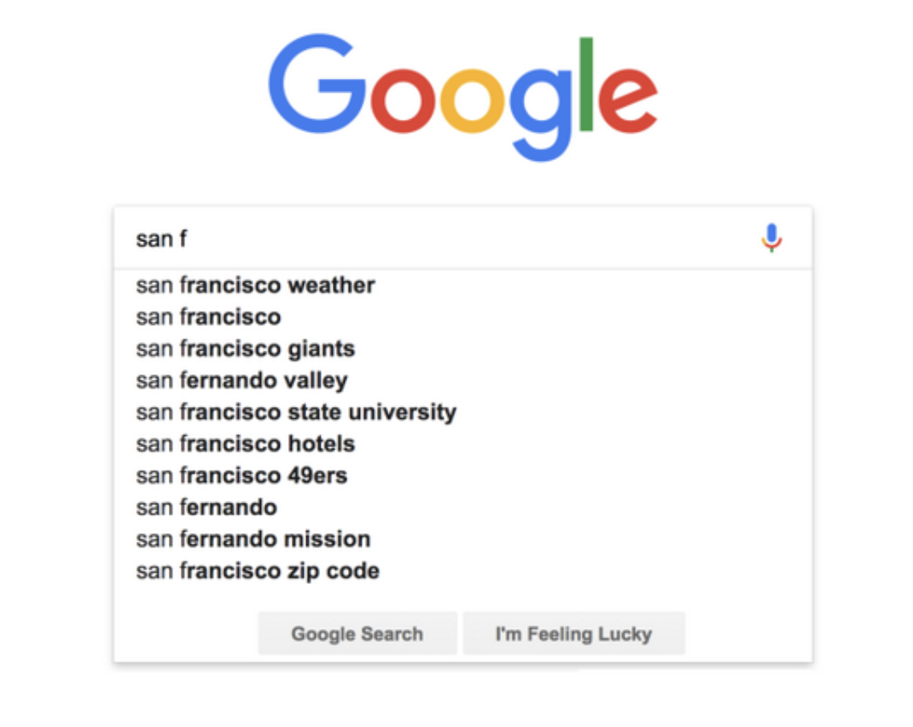
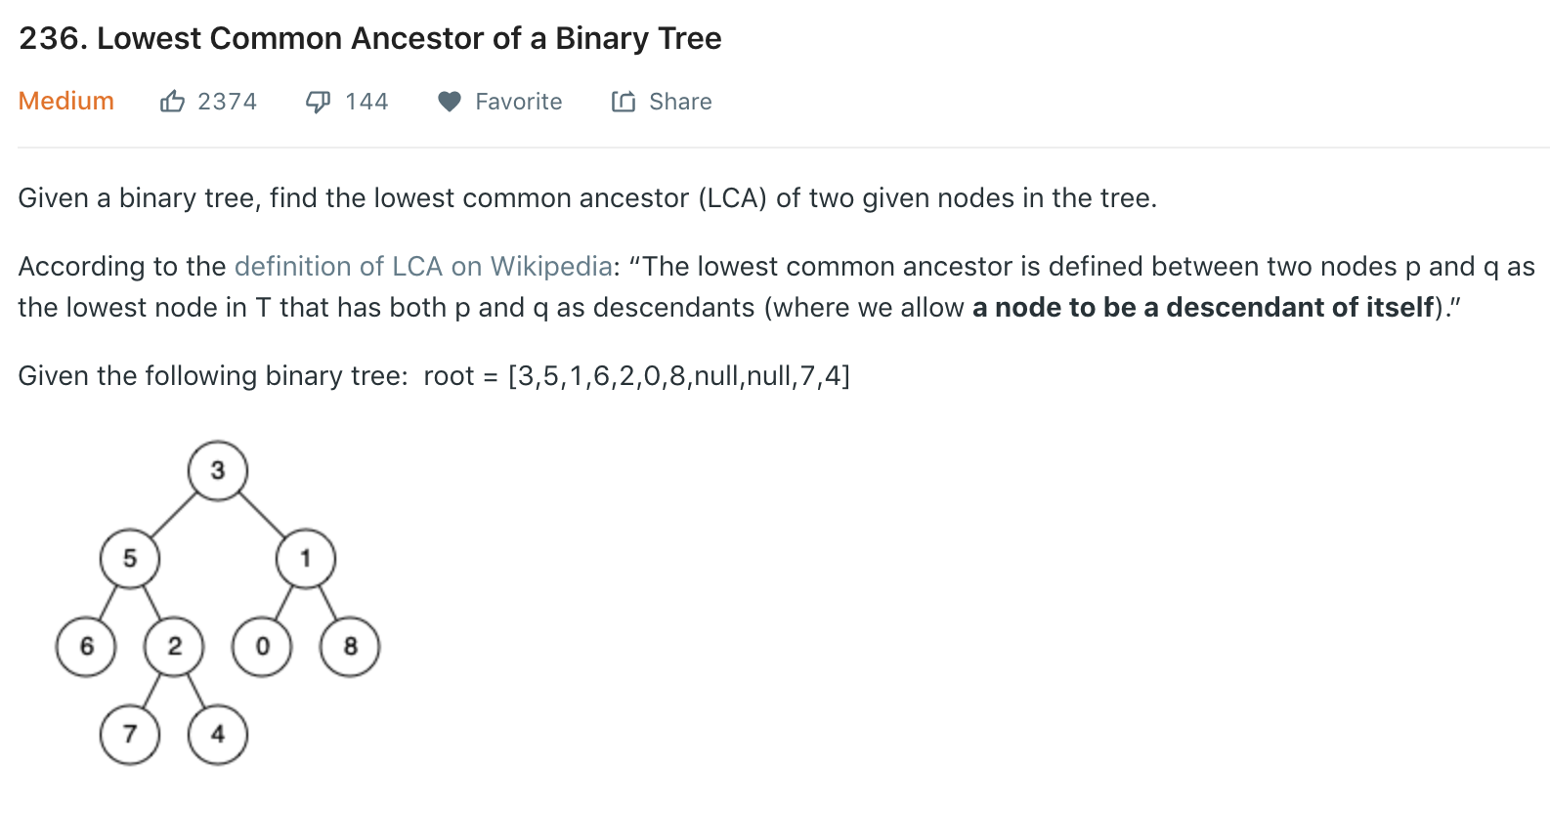
How do you…..?
At work:
“So we need to write an autocomplete feature for our search engine, what’s the best way?”
At interviews:
https://leetcode.com/problems/lowest-common-ancestor-of-a-binary-tree/

Slide 20
Expectation
This course will :
NOT focusing on teaching C++ class, but we will review the basics
Pointer & reference, class, template, etc.
NOT A math class, but we will touch some theoretical topics such as induction as formal proof

Slide 21
C++
We will only review C++ quickly
If in high doubt
CSS332 Programming with object oriented languages
A longer “boot camp” on C++
Although this is not a prerequisite for CSS342, do take this class if at all possible if you are not familiar with C++
Quantitative Skills Center (tutoring) – Visit http://www.uwb.edu/gsc for more information
A good video tutorial series

Slide 22
C++
Let’s see some code (MyArray & Virtual class)

Slide 23
Coding
Naming convention
Not strict
https://gist.github.com/lefticus/10191322
Bottomline:
Pick and follow a rule set
Be consistent

Slide 24
Coding
Avoid duplicates
No same logic more than once!
Comments
On intent, not action
Modular
Cohesion: 1 task per module
Coupling: As loosely coupled as possible
Variable Naming
Jacob’s guide

Slide 25
Coding
Testing
Unit tests
push_back
pop_front
Integration tests
Test Driven Development
Video: “TDD, Where Did It All Go Wrong”

Slide 26
Object-Oriented Analysis And Design
What does “problem solving” mean?
Give a list of elements, implement the following function:
Add an element to the back of the list push_back(…)
Remove an element from the front of the list pop_front(…)
3
9
1
7
5
4
2
0
pushBack(…)
popFront(…)
4
2
0

Slide 27
Object-Oriented Analysis And Design
What does “problem solving” mean?
Give a list of elements, implement the following function:
Add an element to the back of the list push_back(…)
Remove an element from the front of the list pop_front(…)
10 mins, design and write the code
Use array in C++ to storage the data

Slide 28
Object-Oriented Analysis And Design
Let’s see some code

Slide 29
Object-Oriented Analysis And Design
What does “problem solving” mean?
Give a list of elements, implement the following function:
Add an element to the back of the list push_back(…)
Remove an element from the front of the list pop_front(…)
Procedural (aka steps)
Class Entity
array
Array
pushback()
popFront()
Member variables
PushBack()
Member functions
PopFront()
Test
Test()

Slide 30
Design Principals (“Specification” in C++ ch. 1.3)
Modular design
Split a problem into modules (e.g. classes)
Each modules states what it does
No module “know” how any other module works
Applies to
Single application (e.g. main, list, test)
Large scale Microservices (see how Uber does it)
And remember the class scheduling example?

Slide 31
Design Principals (“Specification” in C++ ch. 1.3)
https://medium.com/edureka/microservice-architecture-5e7f056b90f1

Slide 32
Design Principals (“Specification” in C++ ch. 1.3)
Operation Contracts
What methods are available to public
How a method can be used
Inputs
Outputs
Exception
What limitations
Example:
List in C++ Standard Template Library (STL)
Facebook’s /{object-id}/likes API

Slide 33
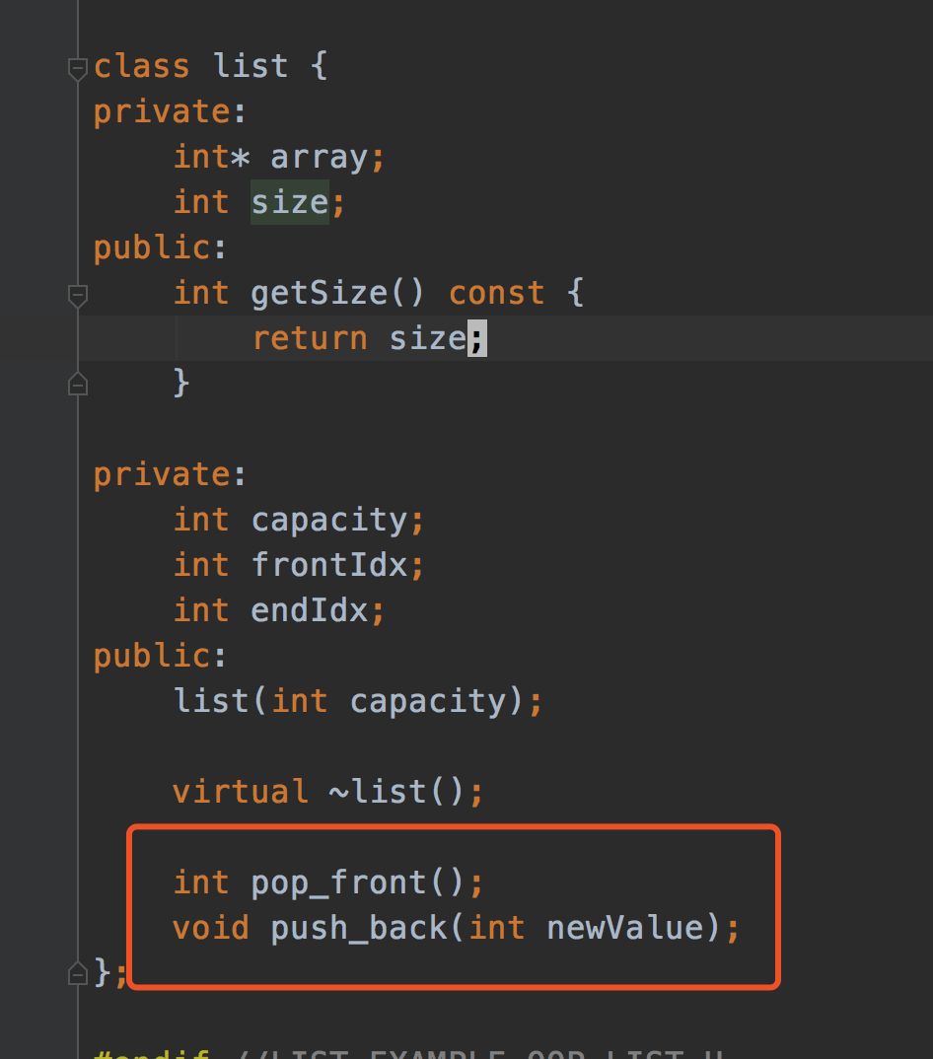
Design Principals (“Specification” in C++ ch. 1.3)
Unusual Conditions
Assume invalid situations never occur
Ignore the invalid situations
Guess (Assume) client’s intention
Return a value signaling a problem
Throw an exception
Error Hiding (swallowing)

Slide 34
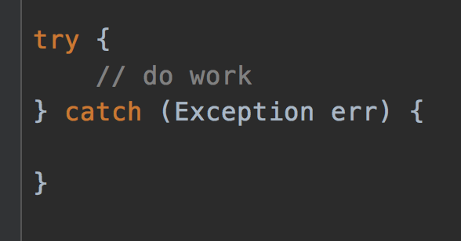
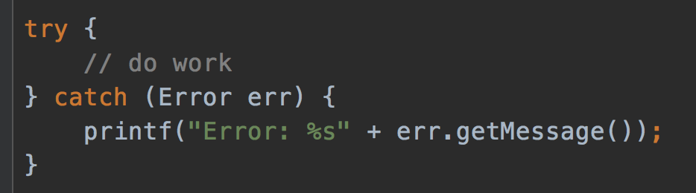
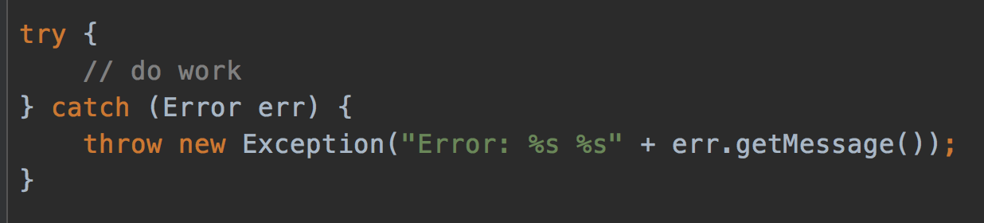
Error hiding
VERY BAD
STILL BAD
GOOD, but how to improve?
https://www.ibm.com/support/pages/best-practice-catching-and-re-throwing-java-exceptions

Slide 35
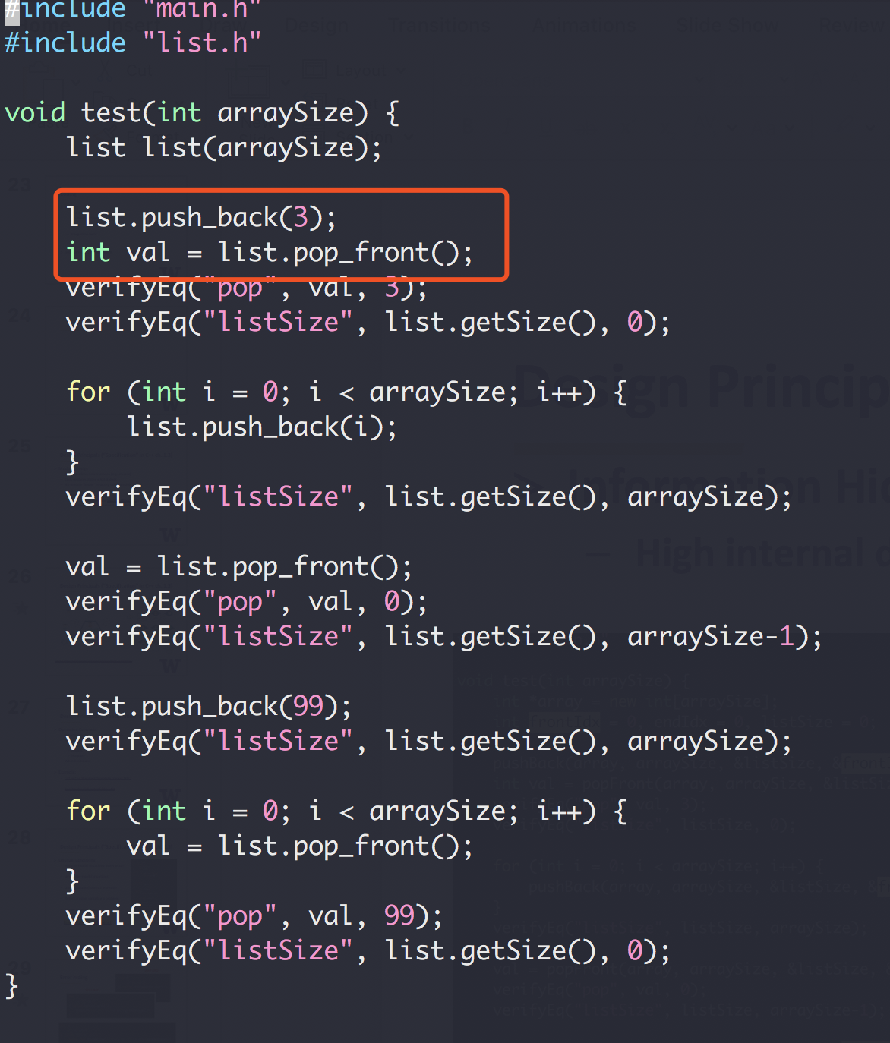
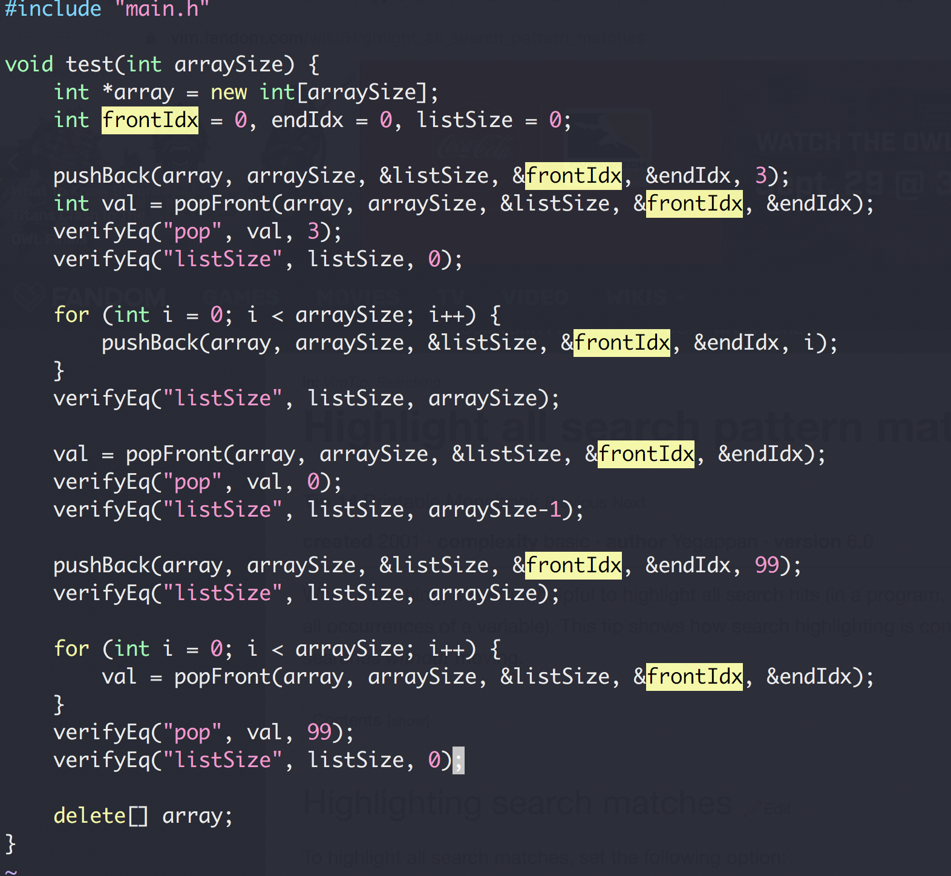
Design Principals (“Specification” in C++ ch. 1.3)
Information Hiding
High internal details from external clients

Slide 36
Homework
Work alone unless specified otherwise
No Plagiarism
“the practice of taking someone else's work or ideas and passing them off as one's own”
Use internet resources for idea is OK if proper credit is given
“I got this algorithm idea from xxx”
Serious consequence!!!
Late homework will NOT be accepted
exception will be given on a very very rare and case by case basis with legit proof of circumstances
Ask questions on disco/slack channels and/or at office hours
Homework 1

Slide 37
OOP Design (Also C++ review)
A bag of card of different shapes
Exercise

